Slide 1



TM-76
DATATHON:
LIFELINE
by Heartware <3
feel free to scan the QR code to see our model!

Slide 2

PROBLEM FRAMING
How can our model classify (Normal / Suspect / Pathologic) from CTG signals to detect early signs of fetal distress?

Slide 3
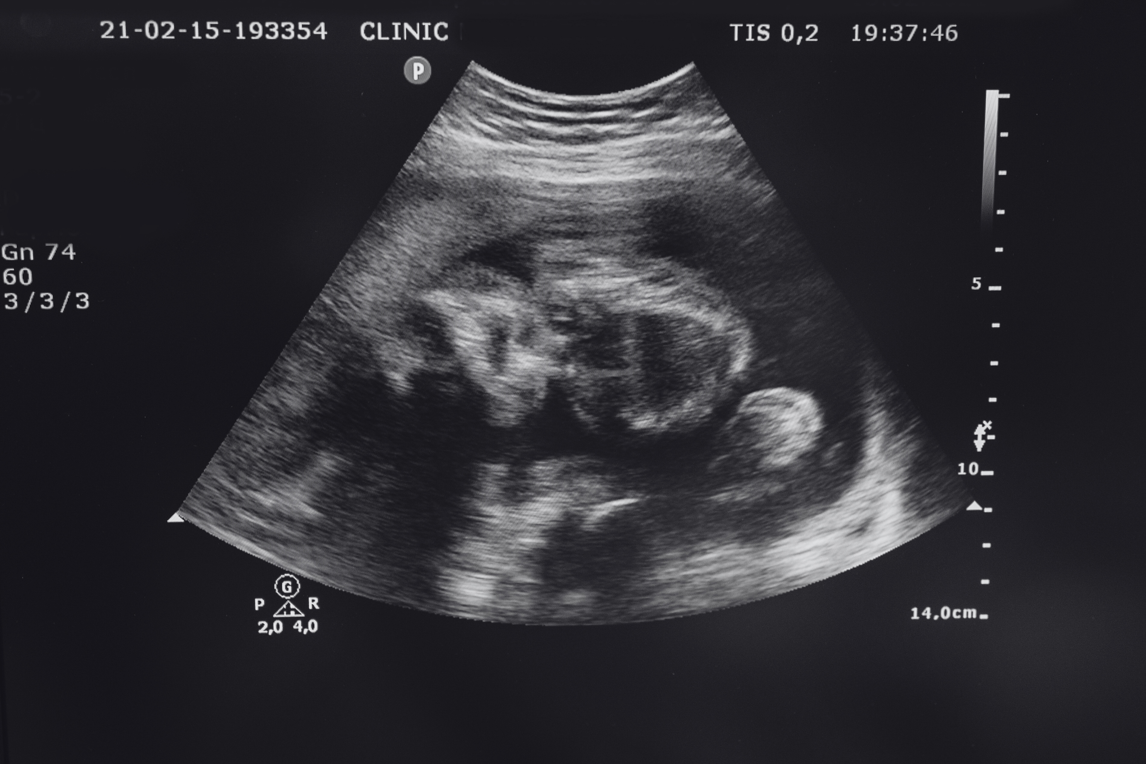

FETAL STATE CLASSIFICATION USING CTG DATA
Objective: Develop an accurate, explainable, and deployable ML model to detect fetal distress.
Dataset: UCI Cardiotocography (CTG)
https://archive.ics.uci.edu/ml/machine-learning-databases/00193/CTG.xls
Tech Stack: scikit-learn | imblearn | SHAP

Slide 4

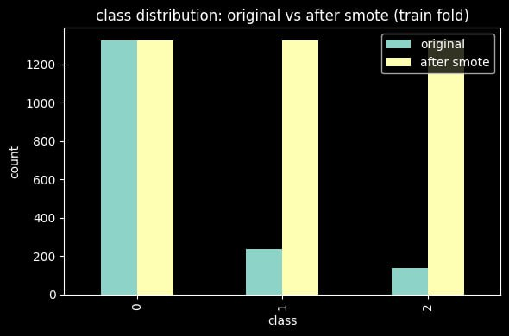
DATA HYGIENE & DATA HANDLING
KEEP RELEVANT VALUES
REMOVE MISSING VALUES
TRAIN/TEST SPLIT 80/20
LABEL CORRECTION (1,2,3) TO (0,1,2)
DATA SCALING AND BALANCING
STANDARDSCALER NORMALIZES FEATURE SCALES
SMOTE OVERSAMPLES MINORITY CLASSES

Slide 5

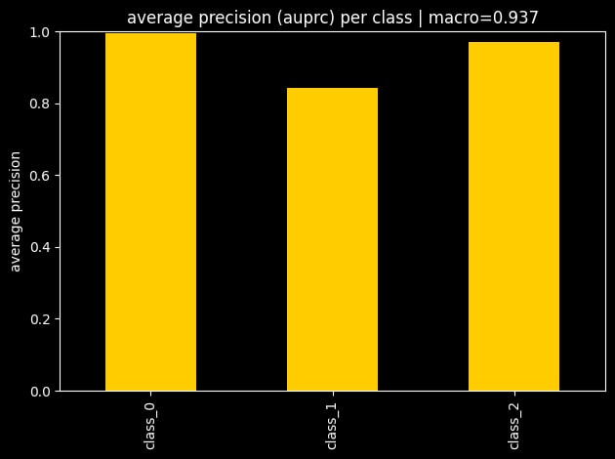
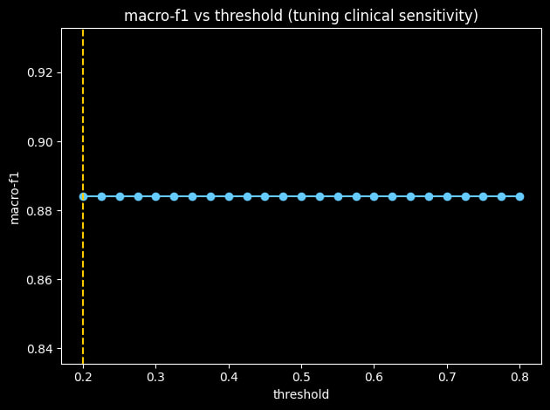
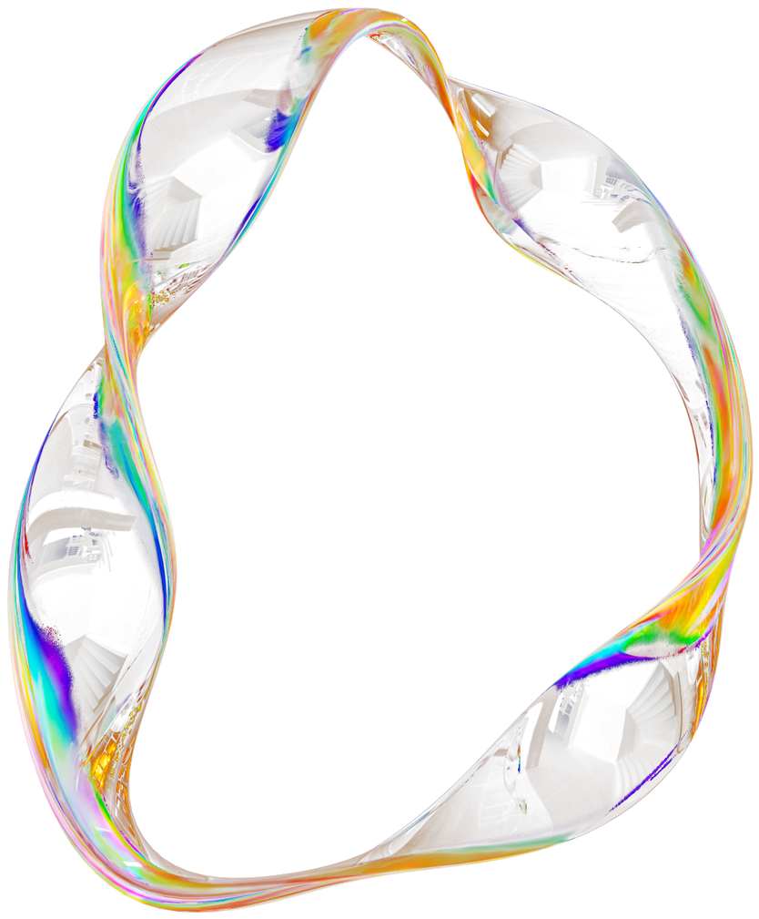
METRICS LITERACY

Slide 6
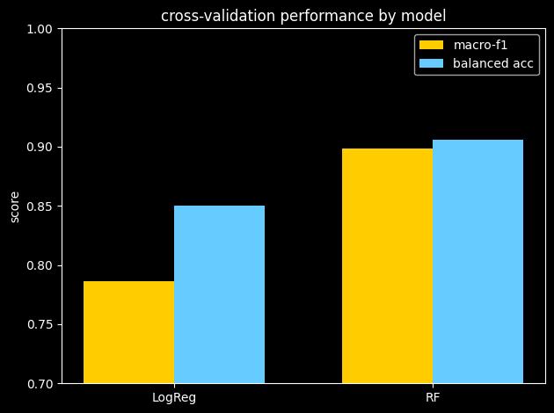
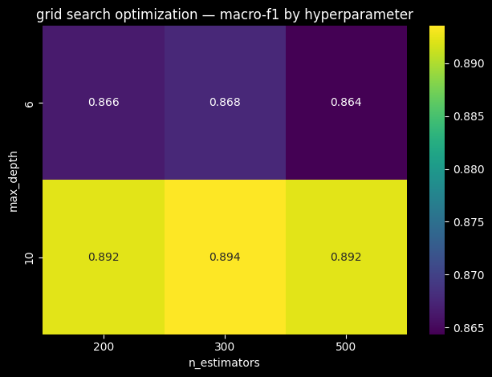
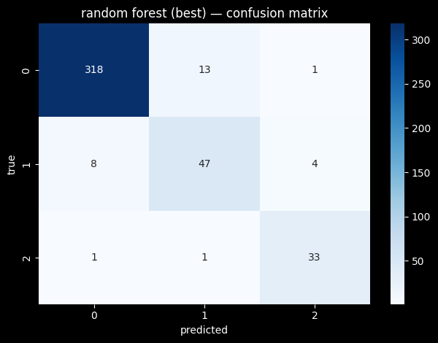
MODEL PERFORMANCE & OPTIMIZATION
Core Approach
Supporting Enhancements
Compare Logistic Regression vs Random Forest.
Use 5-fold Stratified CV scoring Macro-F1 & Balanced Accuracy.
Apply GridSearch on RF (n_estimators, max_depth, min_samples_split).
Evaluate best model on hold-out set.
Cross-validation
Grid search
Hold-out evaluation

Slide 7
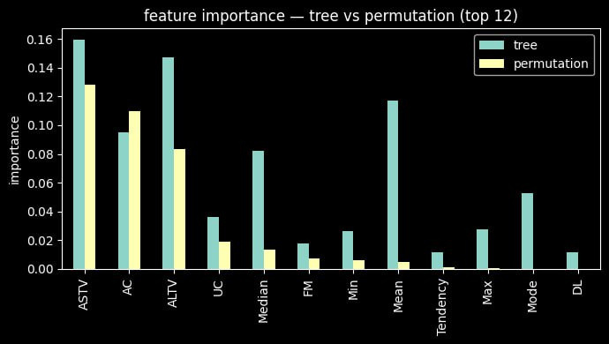

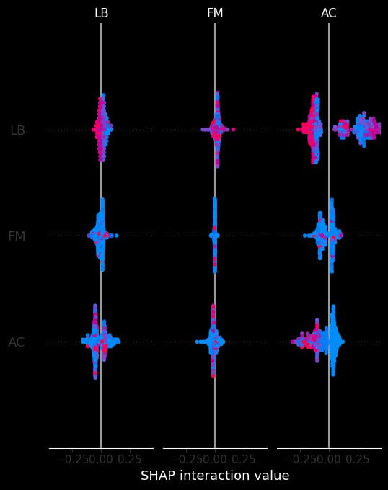
EXPLAINABILITY AND CLINICAL REASONING
Top 10 features:
ASTV
ALTV
Mean
AC
Median
DP
Mode
LB
Variance
Width
Clinical Insight:
High variability → likely normal
Low variability / abnormal baseline → possible fetal distress
Takeaway: Model aligns with medical knowledge → interpretable & trustworthy

Slide 8
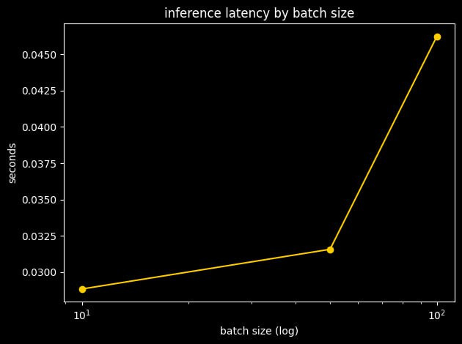
LATENCY AND ENGINEERING
Pipeline: StandardScaler → SMOTE → RF
Fast inference (~milliseconds per sample)
Scalable for batch processing
Suitable for real-time clinical decision support
Latency grows minimally with batch size
enabling real-time inference

Slide 9
TM-76
THANK YOU
for your time and attention
by Heartware <3

